Slide 1
Measurement Lab
Internet Policy and Independent Network Performance Measurement
Chris Ritzo, Collin Anderson
LACNIC 2015
Notes:
As the Internet drives economic and social development, national telecommunications regulators and service providers have an interest in performance data that reflects real-world conditions. Measurement Lab (M-Lab) provides the largest open repository of performance data, collected from broad sample populations, that reflects end-user conditions based on software integrations and partnerships. This dataset is currently used by governments and public interest organizations across North America and Europe, in order to assess the deployment and performance of broadband connectivity. The most recent research from M-Lab’s data exposed episodes of persistent congestion across the United States over the past three years due to network interconnection disagreements. As M-Lab builds out its infrastructure to include more international coverage, it has sought to promote the use of its existing data and increase collaborations in Asia. This presentation will serve as an introduction to the platform as a public resource that provides open, methodologically-based performance and transparency data from the edge, in order to prompt greater use of existing data and tools amongst the providers, regulators and organizations that have an interest in promoting reliable access. We will introduce the measurements that M-Lab is currently collecting and then describe how to access this information through newly release toolkits. The presentation will then use the technical findings of the interconnection study, including discovery of prioritization regimes, to demonstrate trustworthy measurement on controversial issues as a third-party to an underlying network relationship. This presentation will also offer an update on new developments with M-Lab, including new tests and Asian sites, and conclude with an invitation for further collaboration.

Slide 2
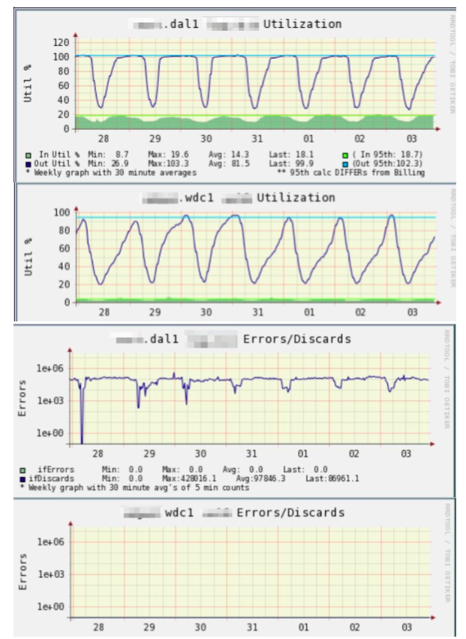
The Regulator’s Problem
Utilization and Performance Data is Proprietary and Hidden from the Public.
User Collected Information is Unreliable, Incomparable, Methodologically Unsound and Narrowly Scoped.
Longitudinal Data is Rare, So Is Comparative Measurement.
Independent Data is Expensive.

Slide 3
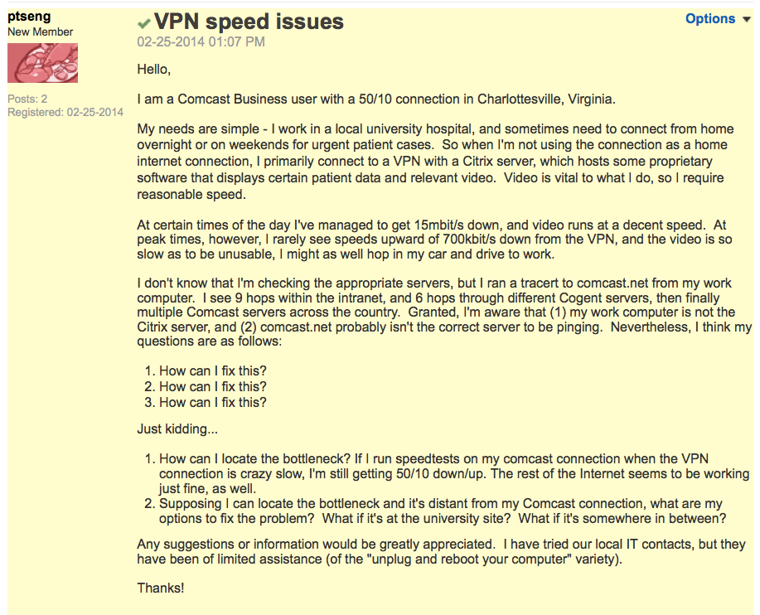
Information Asymmetries Create are Public Issues
Service Providers Need Data

Slide 4
Overview of Measurement Lab

Slide 5
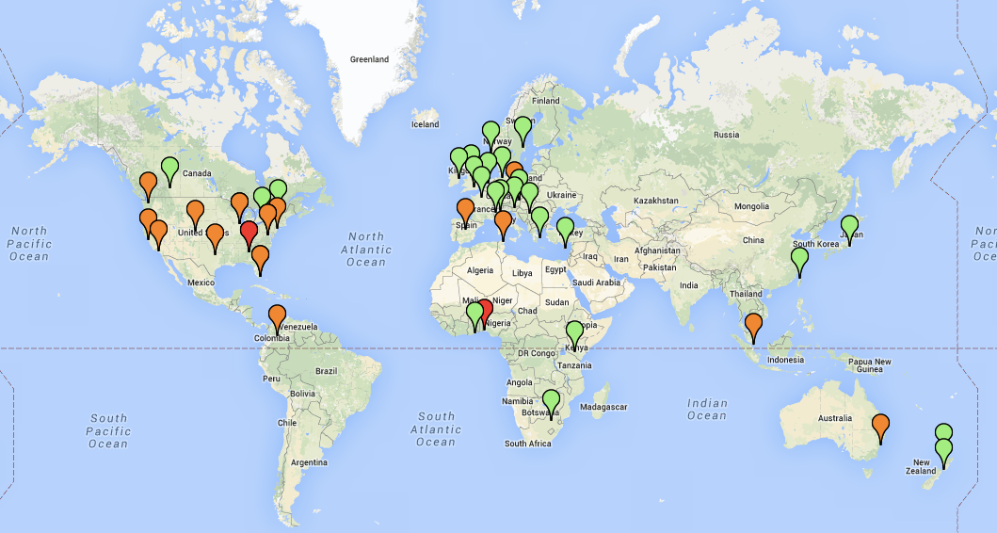
M-Lab’s Global Footprint
Servers on Every Continent and Growing
Notes:
NDT (200,000 tests per day)
Tests of traffic shaping
Path Data for Each Test

Slide 6
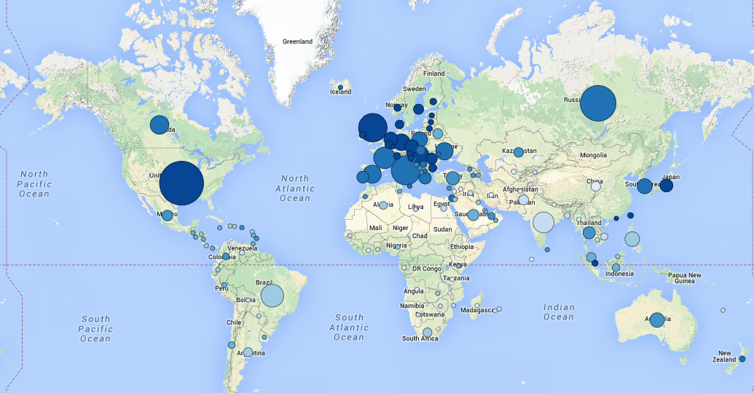
M-Lab’s Global Footprint
Tests from Every Country

Slide 7
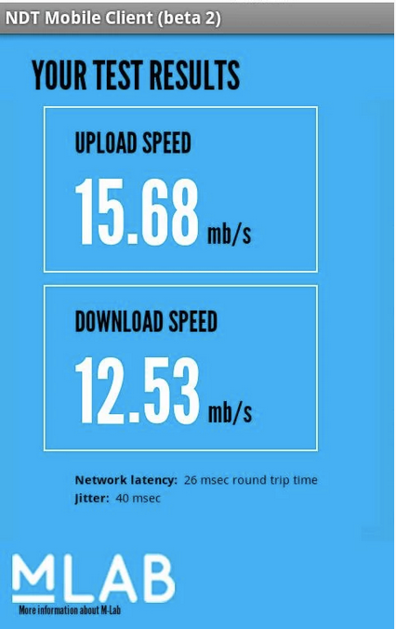
Throughput Measurements
M-Lab hosts two active throughput measurements:
Network Diagnostic Tool (NDT)
BISmark
NDT is integrated with numerous applications and receives 200,000 tests from 100,000 clients per day.
Nearly every country is well-covered.

Slide 8
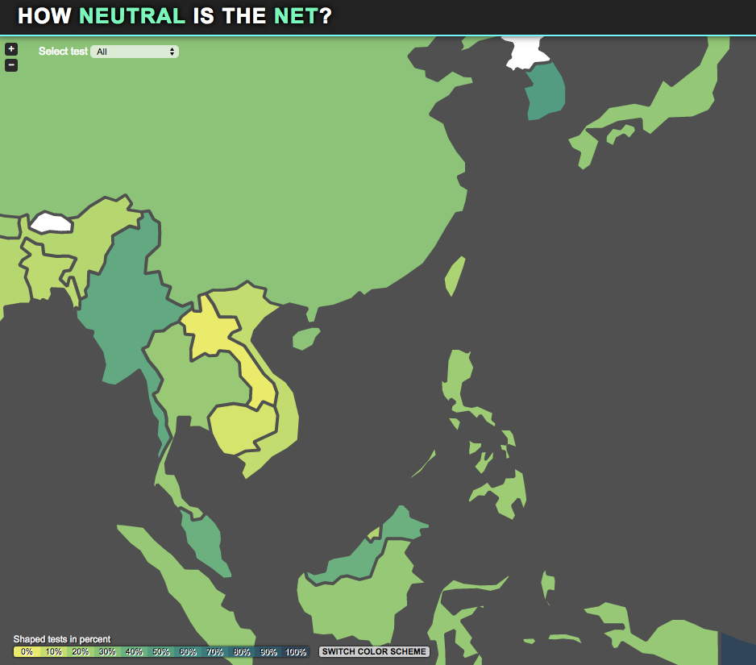
Transparency
Three active tests:
Shaperprobe
Glasnost
Neubot
Measure differential traffic performance and traffic classification regimes.

Slide 9
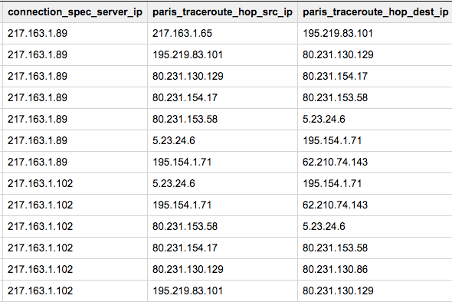
Path Information
Measurement Lab collects paris-traceroutes for every attempt to connect to its sites.

Slide 10

Censorship and Interference
M-Lab Deployed the ‘Open Observatory of Network Interference’ (OONI) Test
First deployment of a censorship measurement tool to OONI
Initial test of HTTP middle boxes

Slide 11
Consumer Measurement and Policy
Methodologies from the Network Edge

Slide 12
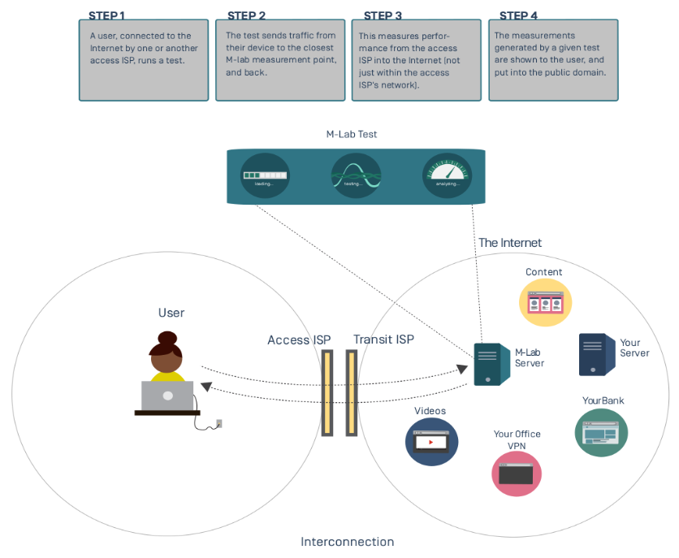
How Measurement Lab Collects Information
Measurements From Everyone

Slide 13
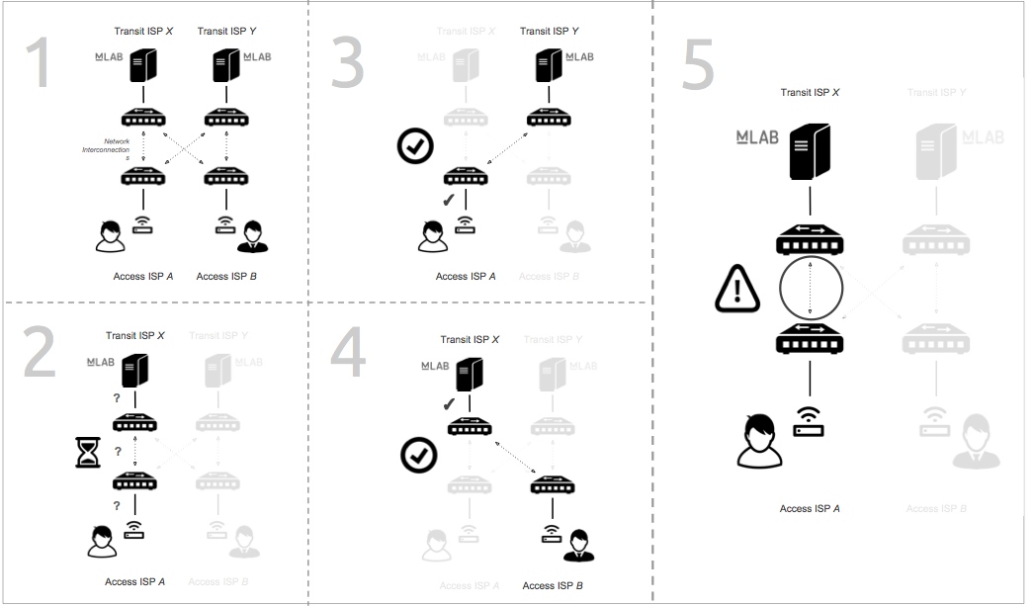
Methodology
Inferring the Source of Congestion

Slide 14
Methodology
Inferring the Source of Congestion

Slide 15
Methodology
Inferring the Source of Congestion

Slide 16
Methodology
Inferring the Source of Congestion

Slide 17
Methodology
Inferring the Source of Congestion

Slide 18
Consumer Internet Measurement Case Study
Interconnection Disputes in the United States

Slide 19
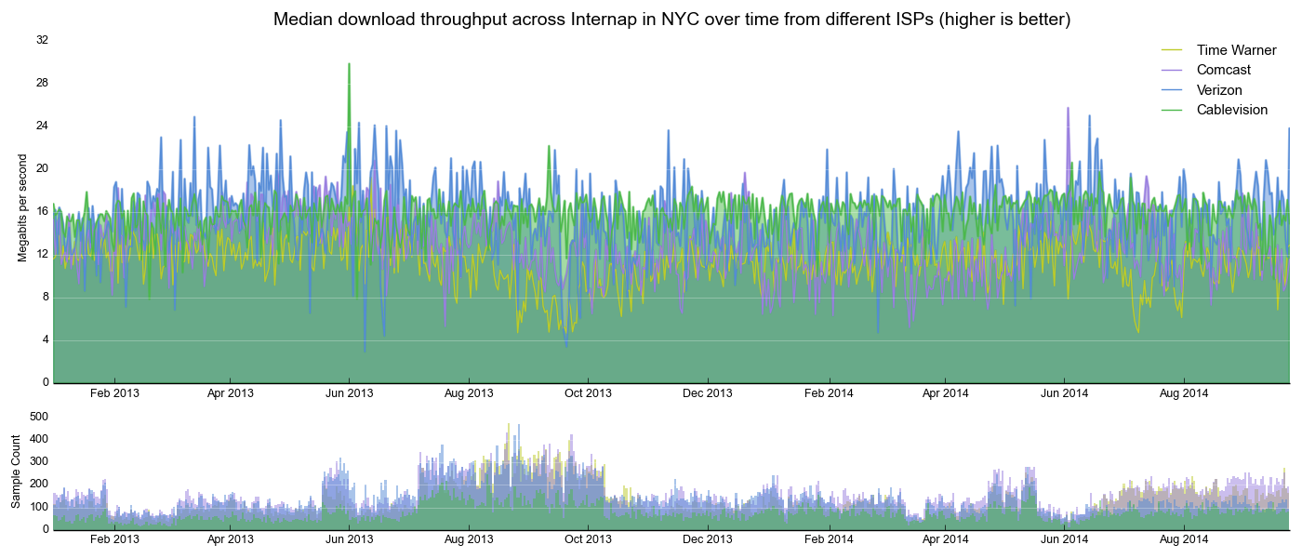
Inferring Sources of Congestion in Practice
US Access ISPs and Cogent (2013-2014)

Slide 20
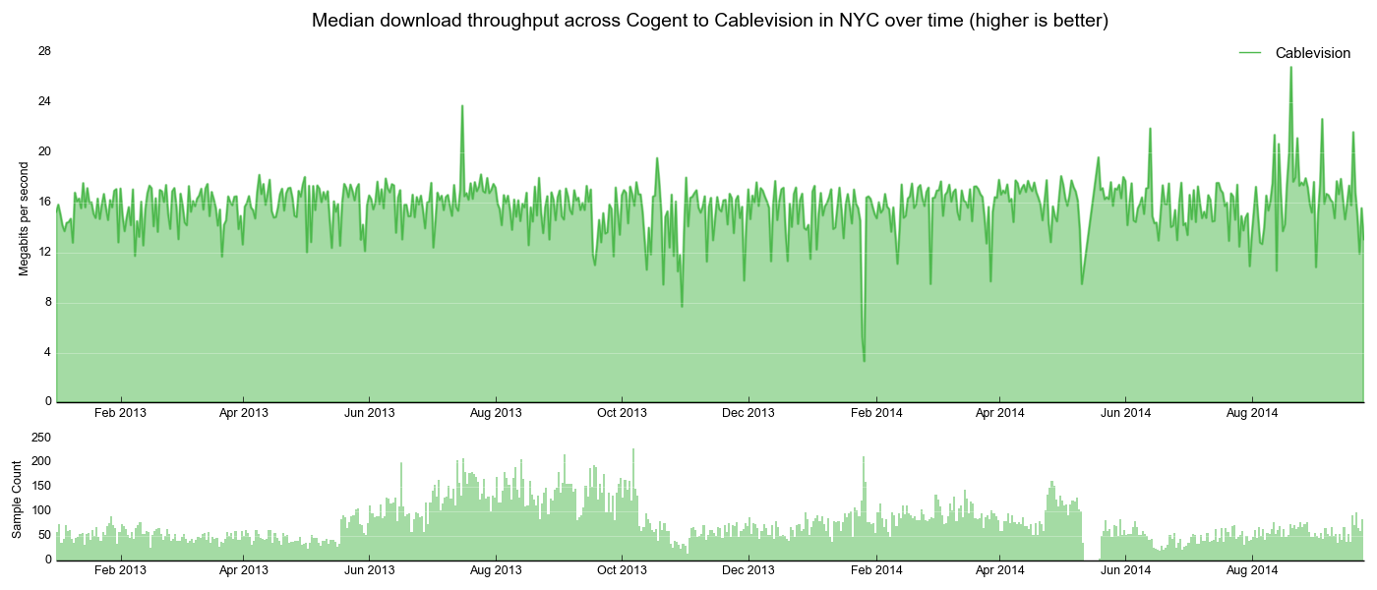
Inferring Sources of Congestion in Practice
US Access ISPs and Cogent (2013-2014)

Slide 21
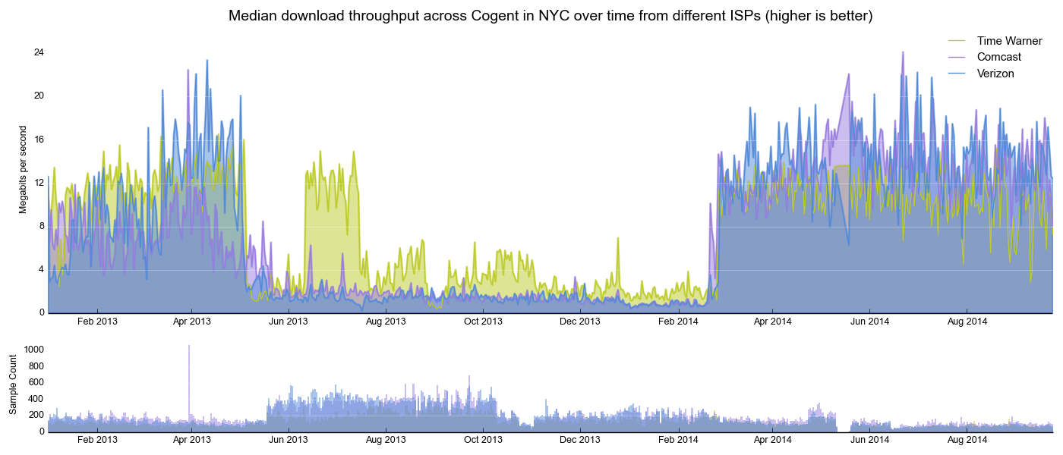
Inferring Sources of Congestion in Practice
US Access ISPs and Cogent (2013-2014)

Slide 22
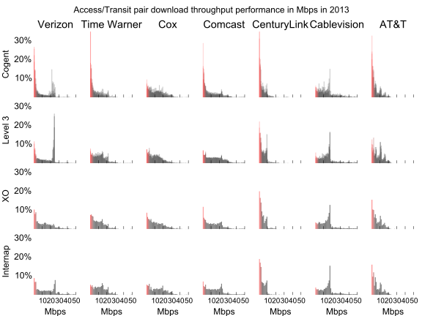
Comparative Performance across ISPs
No Access ISPs or Transit ISPs Universally Underperforming

Slide 23
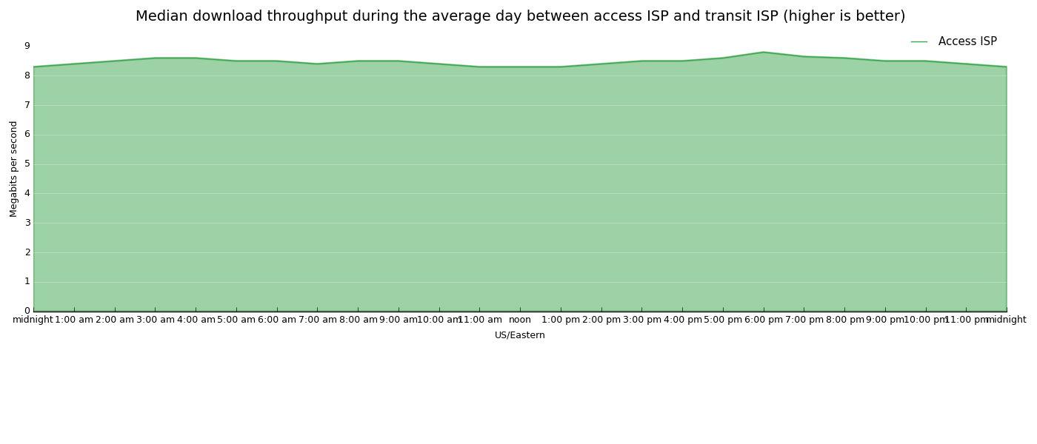
Diurnal Patterns Are Instructive
Expectations of Normal Performance

Slide 24
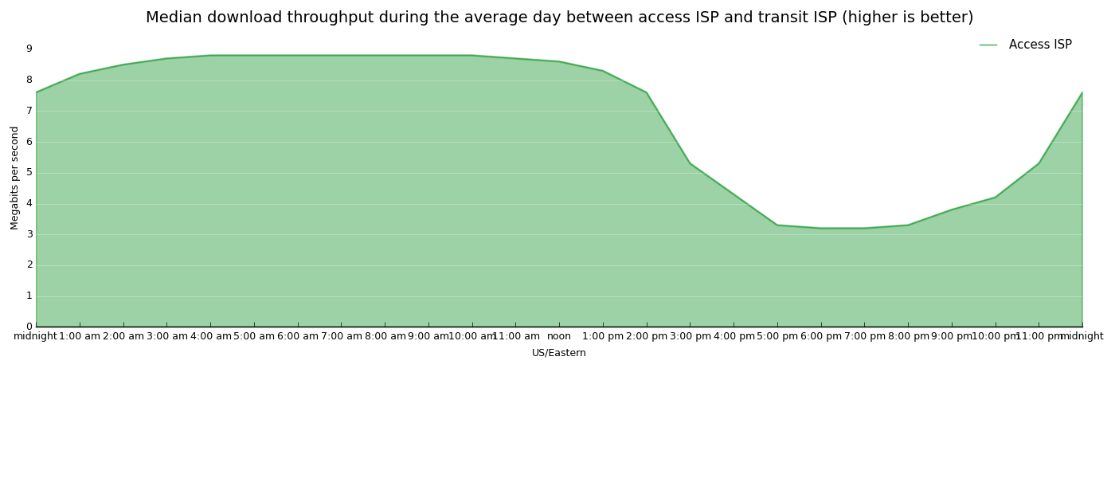
Diurnal Patterns Are Instructive
Expectations of Congested Performance

Slide 25
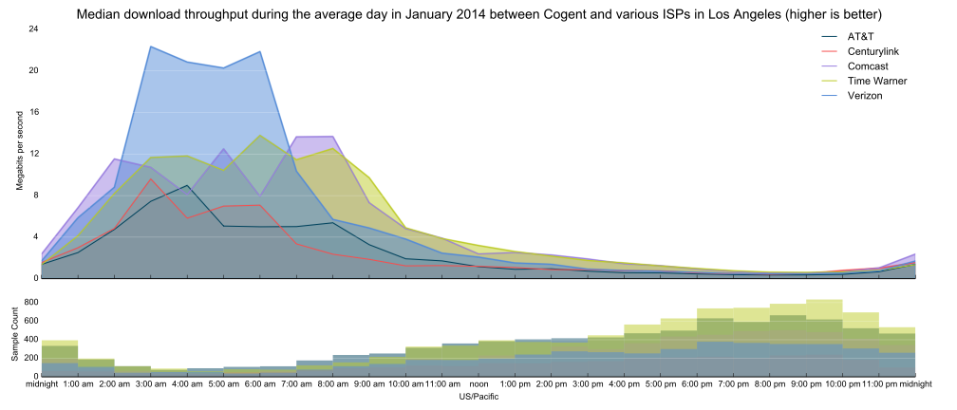
Diurnal Cycles In Practice

Slide 26
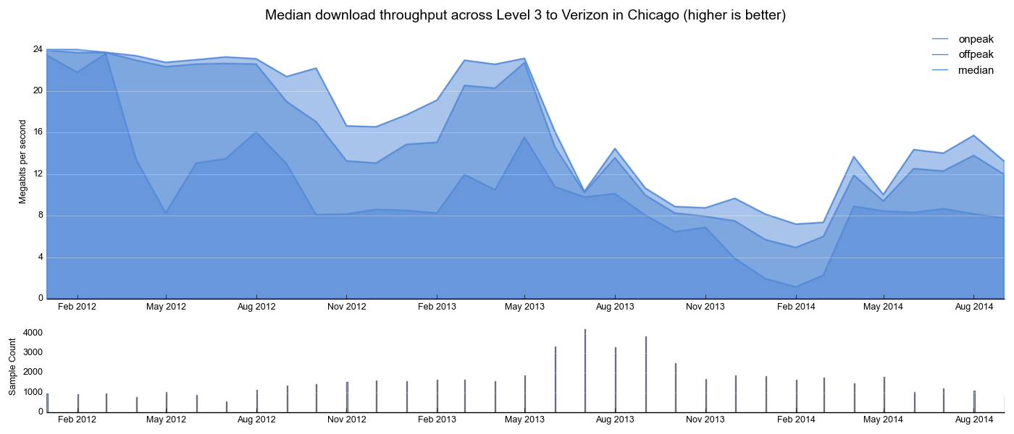
Diurnal Patterns Are Instructive
Peak Congestion Can Augur Future Degradation

Slide 27
Congestion affecting consumers has not been limited to interconnections with Cogent

Slide 28
Level 3 and Verizon
Ongoing

Slide 29
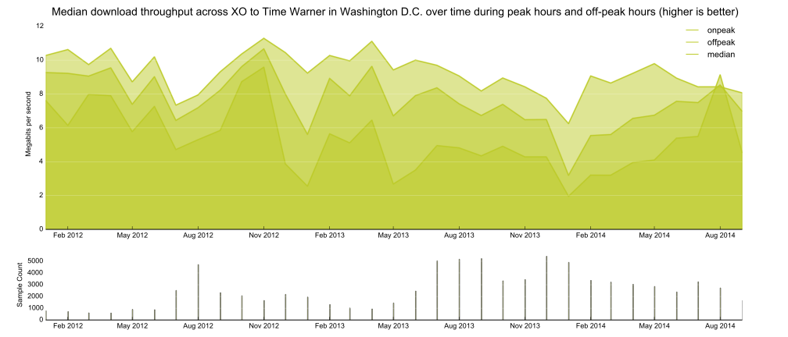
XO and Time Warner Cable
Ongoing

Slide 30
Our data shows that traffic from specific Access ISP customers across interconnections with specific Transit ISPs experienced degraded performance, and that this degradation forms a pattern wherever specific Access ISPs and Transit ISPs exchange traffic.

Slide 31
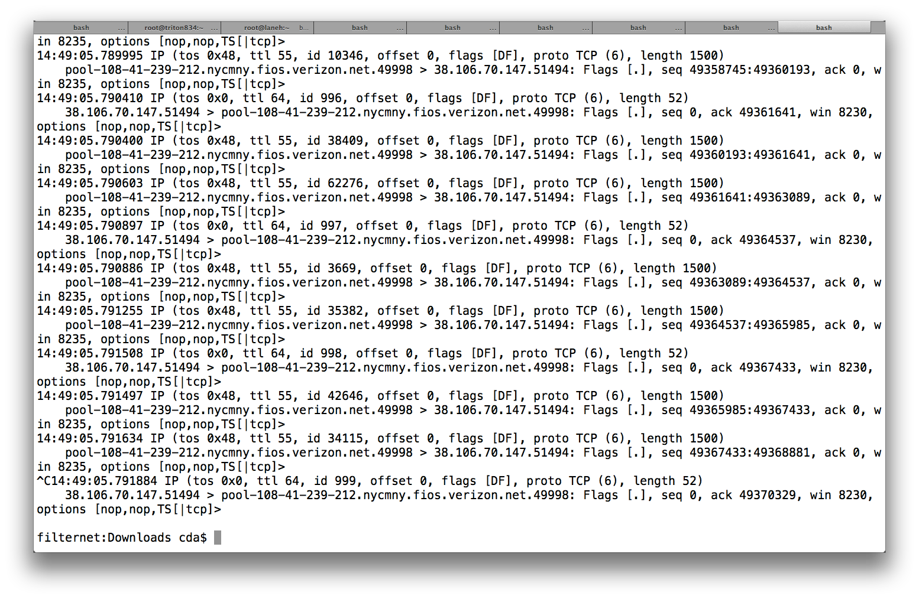
Assessment of Prioritization
Cross the Board Increases

Slide 32
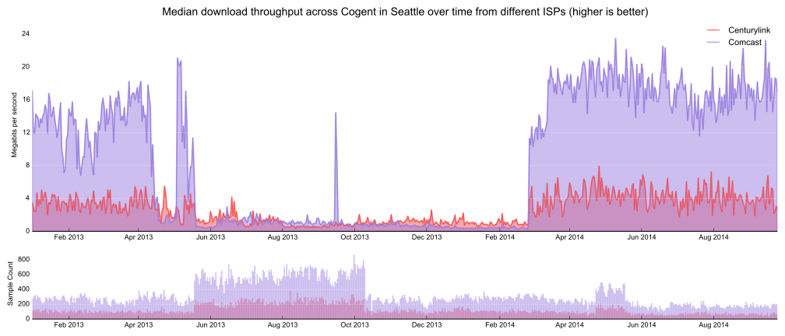
Assessment of Prioritization
Cross the Board Increases

Slide 33
Raw Data Access and Processed Data Extraction Tools

Slide 34

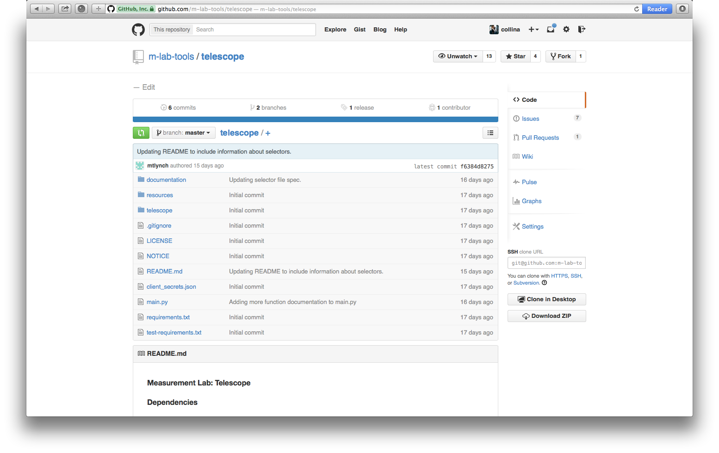
Measurement Lab Telescope
Python to extract M-Lab data

Slide 35
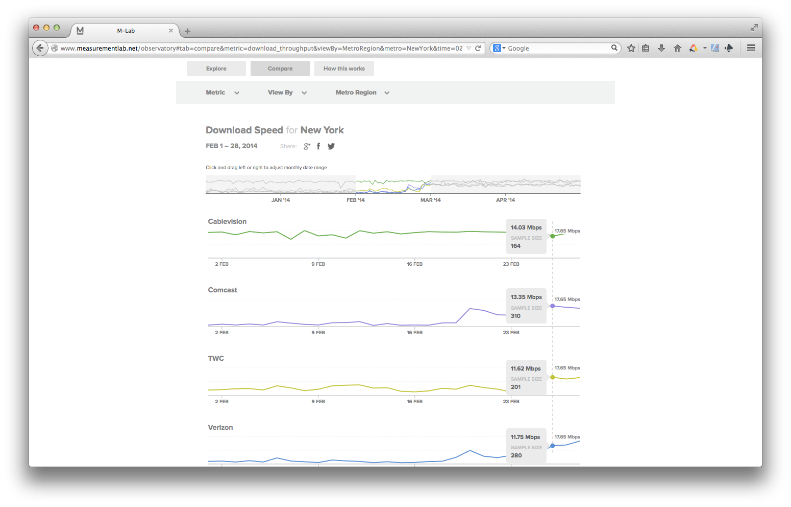
Measurement Lab Observatory
Currently US Only

Slide 36
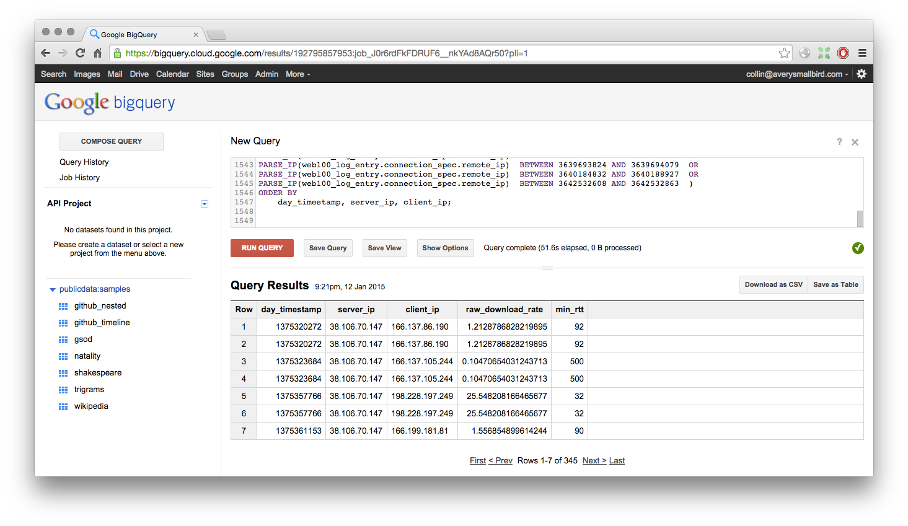
Raw Data: BigQuery
Structured Database Access

Slide 37
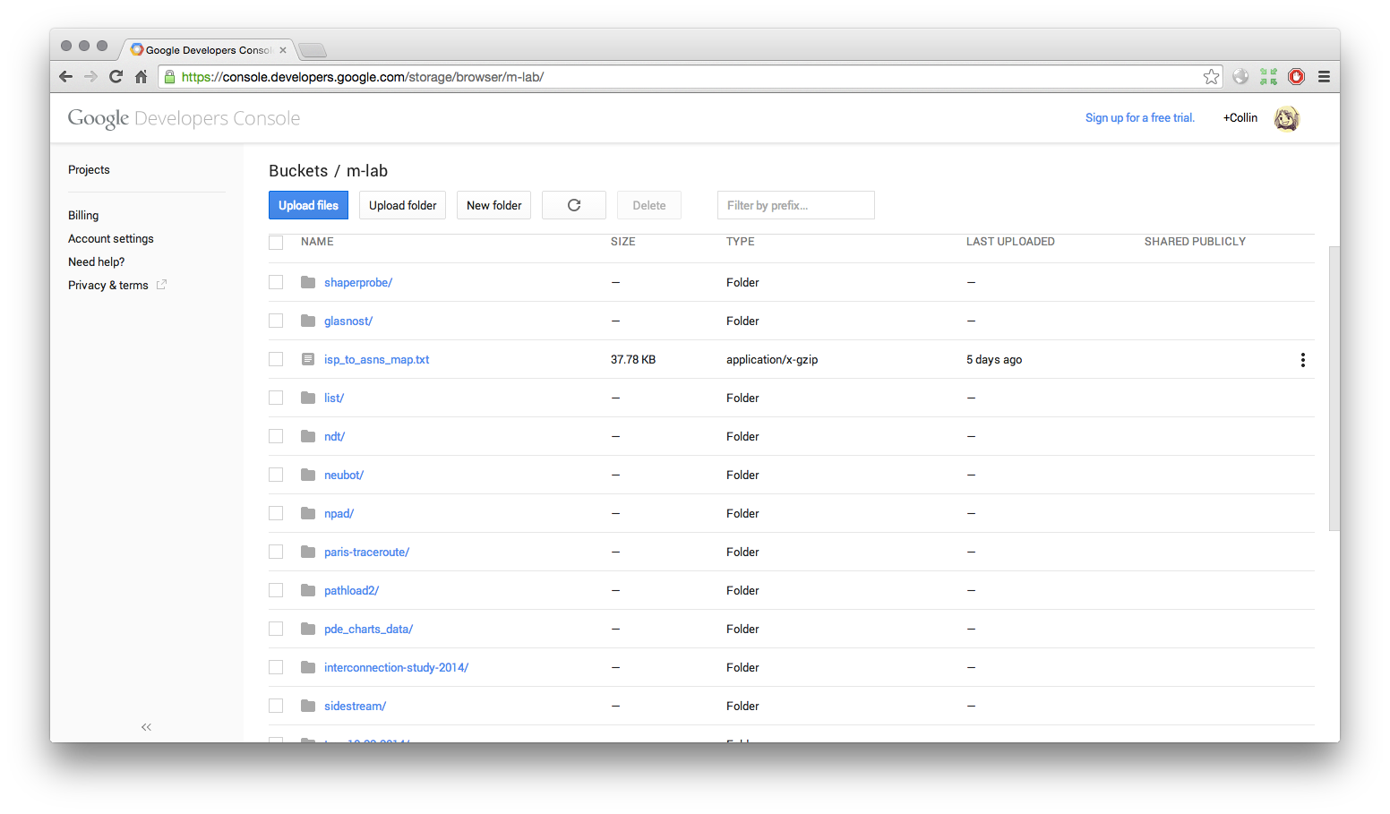
Raw Data: Cloud Storage
Raw Datafile Access

Slide 38
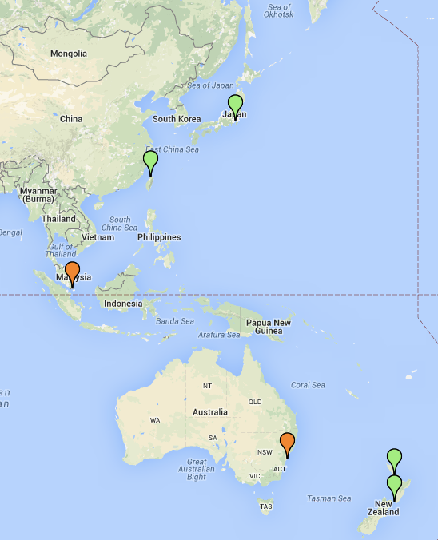
Growing the Network

Slide 39
There is still much more in Measurement Lab’s dataset. Please explore.
measurementlab.net

